Slide 1
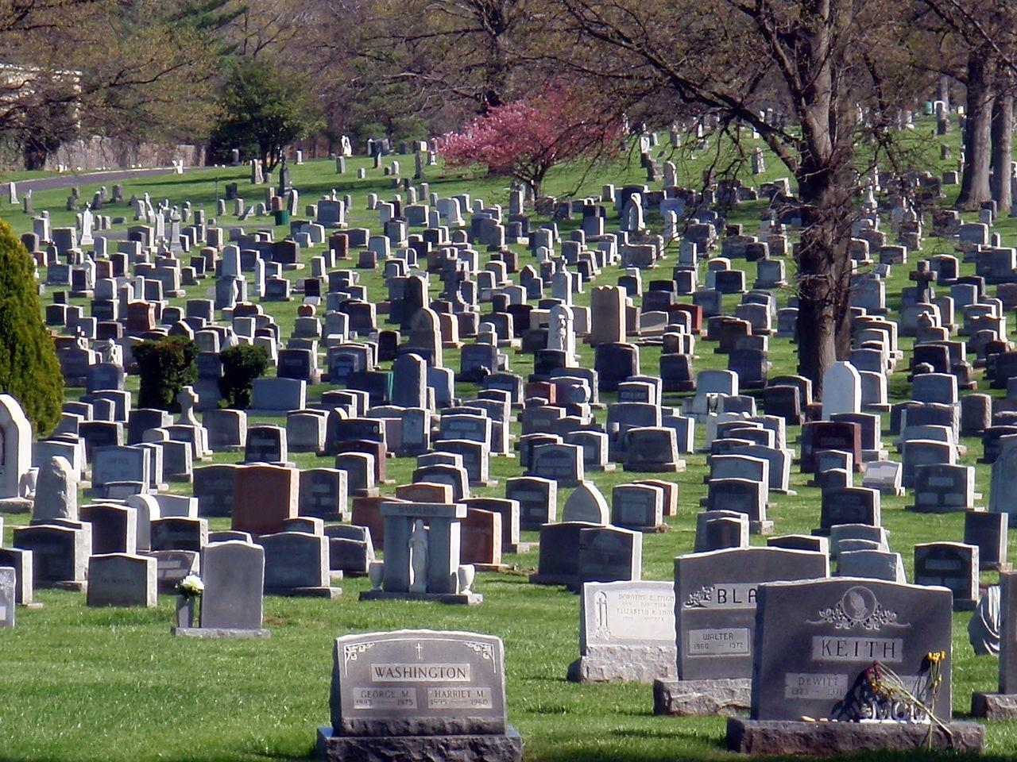

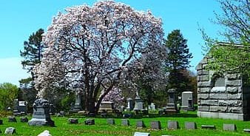
Facts About the Nashville City Cemetery
Sobiya Khan

Slide 2
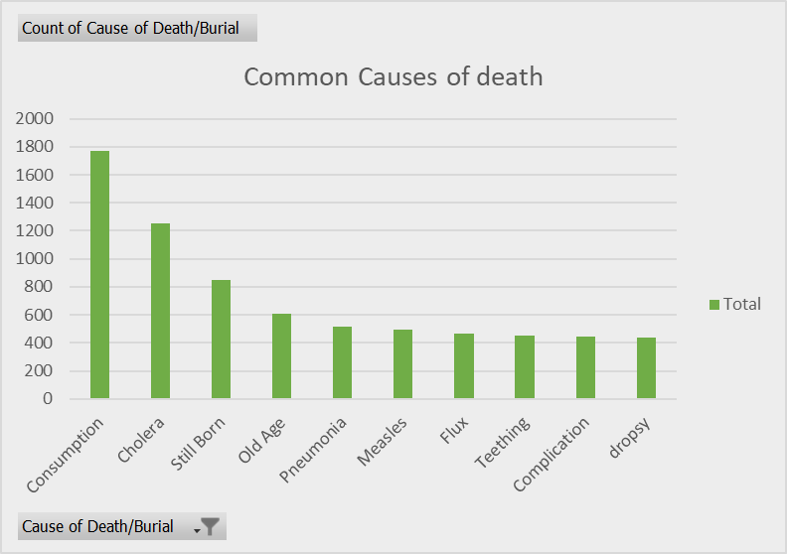
10 Most common causes of death from 1846 - 1978
Common causes of death:
Consumption
Cholera
Still Born
Old Age
Pneumonia
Measles
Flux
Teething
Complication
Dropsy

Slide 3
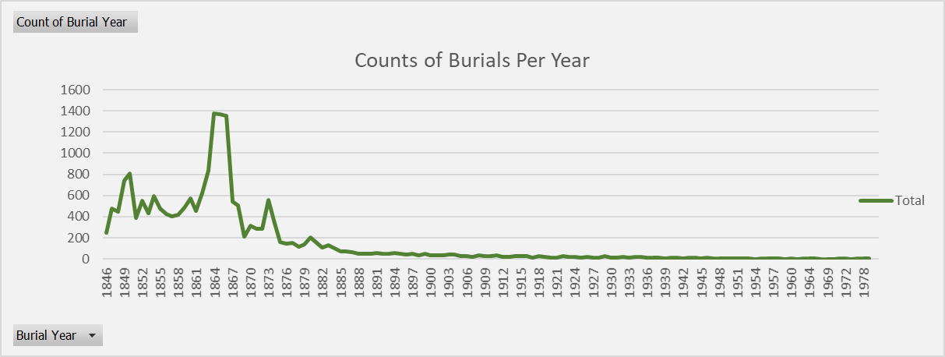
Burials Per Year
Most burials were around the years 1864-1866. Pneumonia was often a deadly disease during the 18th and 19th century and most fatal of all diseases due to the lack of the existence of antibiotics. Bacteria had yet to be discovered as a cause of disease around that time.

Slide 4
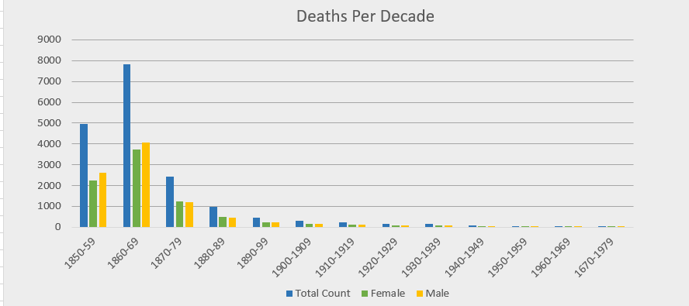
Number of deaths per decade (1850-1979)
After a sudden increase of both male and female deaths from 1850-1869, the death rate of both genders began decreasing. Furthermore, From 1850-1869 the amount of male deaths per decade was slightly higher than the female. However, from 1870-1979, with the exception of 1940-1949, the female death rate was higher.

Slide 5
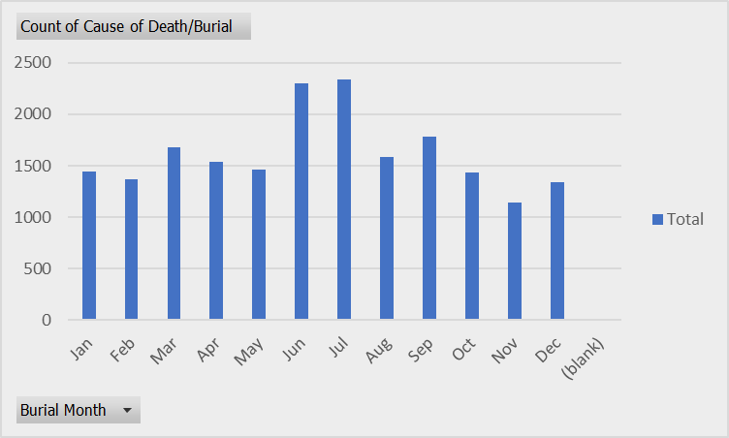
Burial / month
Top 5 causes of death-
Cholera
Brain fever
Consumption
Still born
Measles

Slide 6
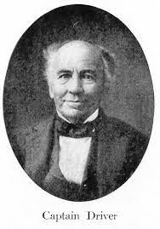
Most common last names / Famous person buried
Last Names
Green
Foster
Wright
Wilson
White
Captain William Driver:
The man who nicknamed the American Flag: “Old Glory”

